Slide 1

GAYATRI VIDYA PARISHAD COLLEGE FOR DEGREE AND PG COURSES(A
(Affiliated to Andhra University)
Department of Computer Applications
MUSIC AND GAME RECOMMENDATIONS
BASED ON EMOTION IN VOICE
By
K. ManojKrishna
PG222302032(MCA)
Under the Guidance of
Mr. A.V. Prabhakar
Assistant Professor
Department of computer Applications

Slide 2
Contents
Abstract
Existed System
Proposed System
Flow chart
Proposed Methodology
Technology/Algorithm used
Functional Requirements
Non-Functional Requirements
Uml Diagrams
Screens
Conclusion

Slide 3
ABSTRACT
Emotion plays a crucial role in human communication, significantly impacting our interactions and decision-making processes. This project explores the innovative integration of Speech Emotion Recognition (SER) technology with personalized entertainment recommendations. By analyzing vocal inputs, the system identifies the speaker's emotional state using advanced machine learning algorithms. Once the emotion is detected, the system recommends tailored music playlists and games that align with the user's current mood. This fusion of SER with personalized entertainment aims to enhance user experiences by providing emotionally congruent content, fostering emotional well-being, and potentially offering therapeutic benefits. Our approach leverages a robust dataset for training the SER model and employs collaborative filtering techniques for recommendation, ensuring relevance and personalization. This project not only showcases the potential of emotion-aware technologies but also paves the way for more empathetic and responsive digital environments.

Slide 4
EXISTING SYSTEM:
The current system for emotion recognition in voice focuses on accurately identifying emotional states such as happiness, sadness, anger, and calmness by analyzing vocal features like tone, pitch, speed, and intensity. Utilizing advanced AI and ML models trained on comprehensive datasets like CREMA and RAVDESS, this system achieves high precision in emotion detection. However, it does not extend its functionality to recommend personalized content like songs or games based on the detected emotions. This limitation means that while the system effectively recognizes and categorizes emotions, it stops short of leveraging this information to enhance user experiences through tailored content recommendations. Without integrating recommendation capabilities, the system misses the opportunity to create a more interactive and emotionally responsive user interface that could improve user engagement and satisfaction. Consequently, there remains significant potential for future development to bridge this gap and fully harness the power of emotion recognition technology. By incorporating personalized content suggestions, the system could provide a more holistic and dynamic user experience that responds to individual emotional states

Slide 5
PROPOSED SYSTEM
The proposed system builds upon the existing emotion recognition capabilities by incorporating personalized content recommendations for songs and games based on the detected emotional states.
▪ Utilizing the same advanced AI and ML models trained on datasets like CREMA and RAVDESS for accurate emotion detection, this enhanced system analyzes vocal features to classify emotions such as happiness, sadness, anger, and calmness.
▪ Upon identifying a user’s emotional state, the system leverages a recommendation engine to suggest music tracks and games tailored to the user’s current mood.
▪ For instance, when a happy emotion is detected, the system might recommend upbeat and energetic songs or fast-paced, fun games.
▪ Conversely, if sadness is identified, the system could suggest comforting and empathetic music or story-driven, immersive games. This integration aims to create a more personalized and engaging user experience by aligning entertainment options with the user’s emotional needs.

Slide 6
Flowchart
start
User records or upload audio
Voice data processing
Check user preferences
Emotion detected
Emotion prediction model
preferences
Display Recommendations
End

Slide 7


Technology / algorithm used
Object Detection and Recognition: CNNs are utilized to detect and localize various attributes of audio such as amplitude, size, pitch, and defects. This includes identifying features like bruises, discolorations, or irregularities in the fruit's surface.
Scene Understanding: CNNs analyze the overall scene including lighting conditions, background clutter, and other environmental factors that may affect the appearance of the audio. This helps in determining the context in which the audio is situated and aids in making accurate quality assessments.
Audio Segmentation: CNNs segment fruit images into different regions such as audio, damaged areas, and background. This detailed segmentation provides valuable insights into the condition of the audio and assists in quality grading.

Slide 8
Functional ReqUIrements
INPUT
OUTPUT
Admin:
Validate User Login Credentials ,Take Audio Input.
USER:
Login Credentials, Audio.
Admin:
Detect their Emotion and Recommend Music Playlist and also Games
USER:
Detect their Emotion and Play Song , games.

Slide 9
NON-Functional ReqUIrements
Performance: The system must process vocal expressions and provide music recommendationsand games instantly. Ensure minimal delay in capturing, analyzing expressions, and suggesting music, games.
Scalability: The system should be able to support a growing number of users without performance degradation. Ability to scale resources up or down based on demand.
Reliability: The system should function correctly under various conditions. Ability to recover from failures without affecting user experience.

Slide 10
NON-Functional ReqUIrements
Security: Protect users’ vocal data and personal information. Ensure secure data transmission between user devices and servers. Implement robust user authentication and access controls.
Availability: The system should be accessible and operational almost all the time. Have plans in place for recovering from catastrophic failures.
Usability: The application should be easy to navigate and intuitive to use. Ensure the system is accessible to users with disabilities.

Slide 11
NON-Functional ReqUIrements
Software Requirements:
Operating System : Microsoft Windows Version 11
Web Browser : Any browser of latest version
Frontend/GUI tool : HTML/CSS/JavaScript.
Programming language : Python
Hardware Requirements:
Processor :Intel i3 & above
RAM :2 GB
Hard Disk :512 GB

Slide 12
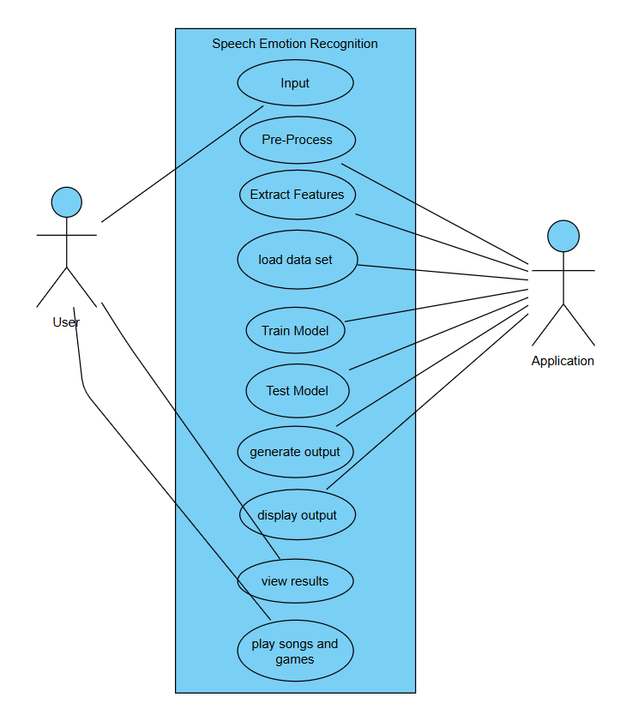
USE CASE DIAGRAM

Slide 13
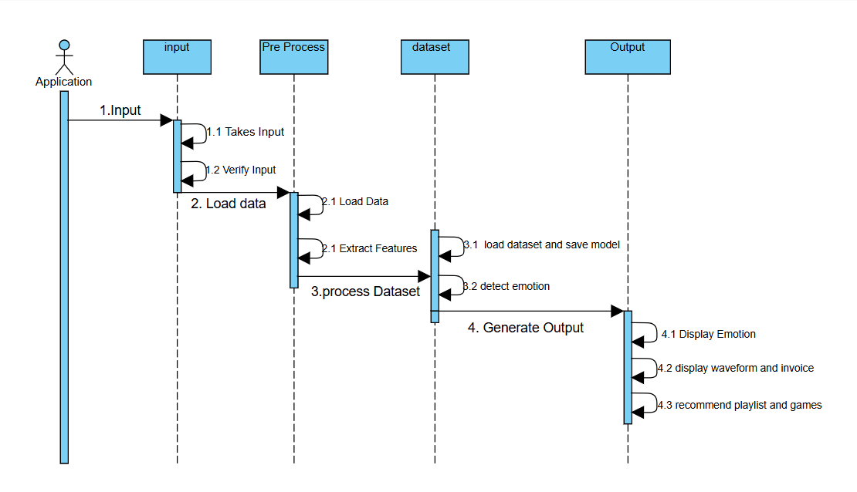
SEQUENCE DIAGRAM of Application

Slide 14
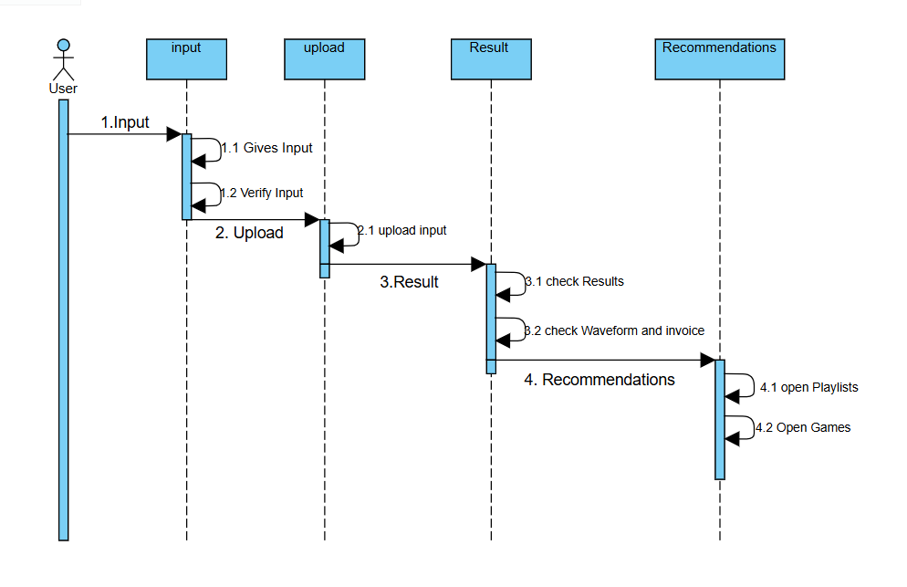
SEQUENCE DIAGRAM FOR user

Slide 15
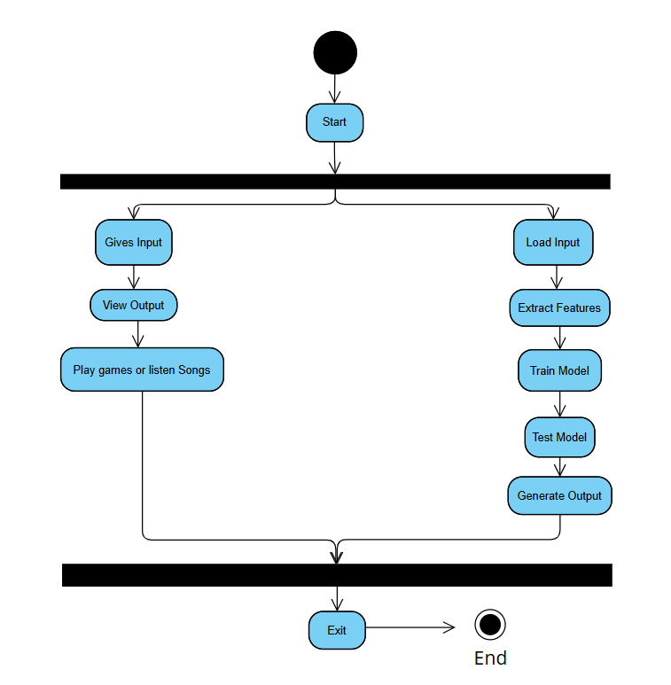








Activity Diagram

Slide 16
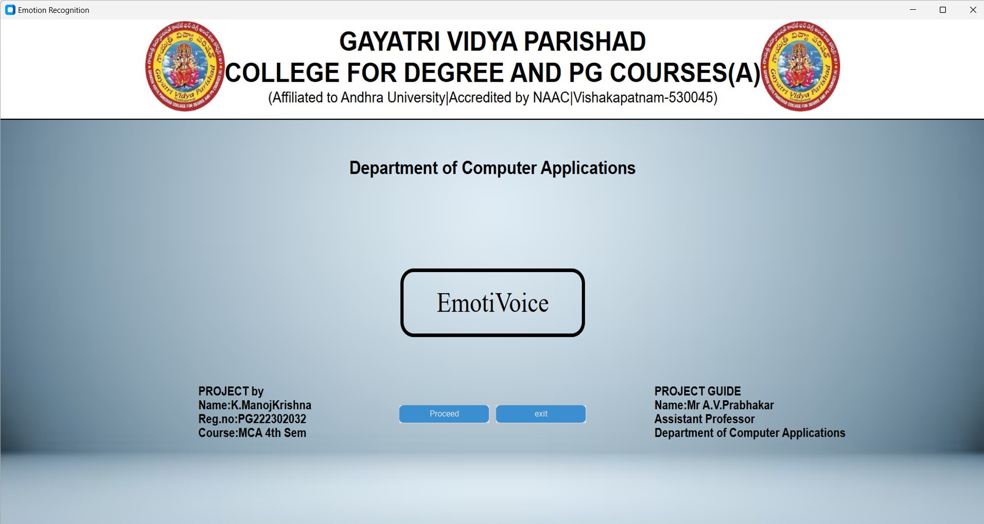
Screens
Start Page

Slide 17
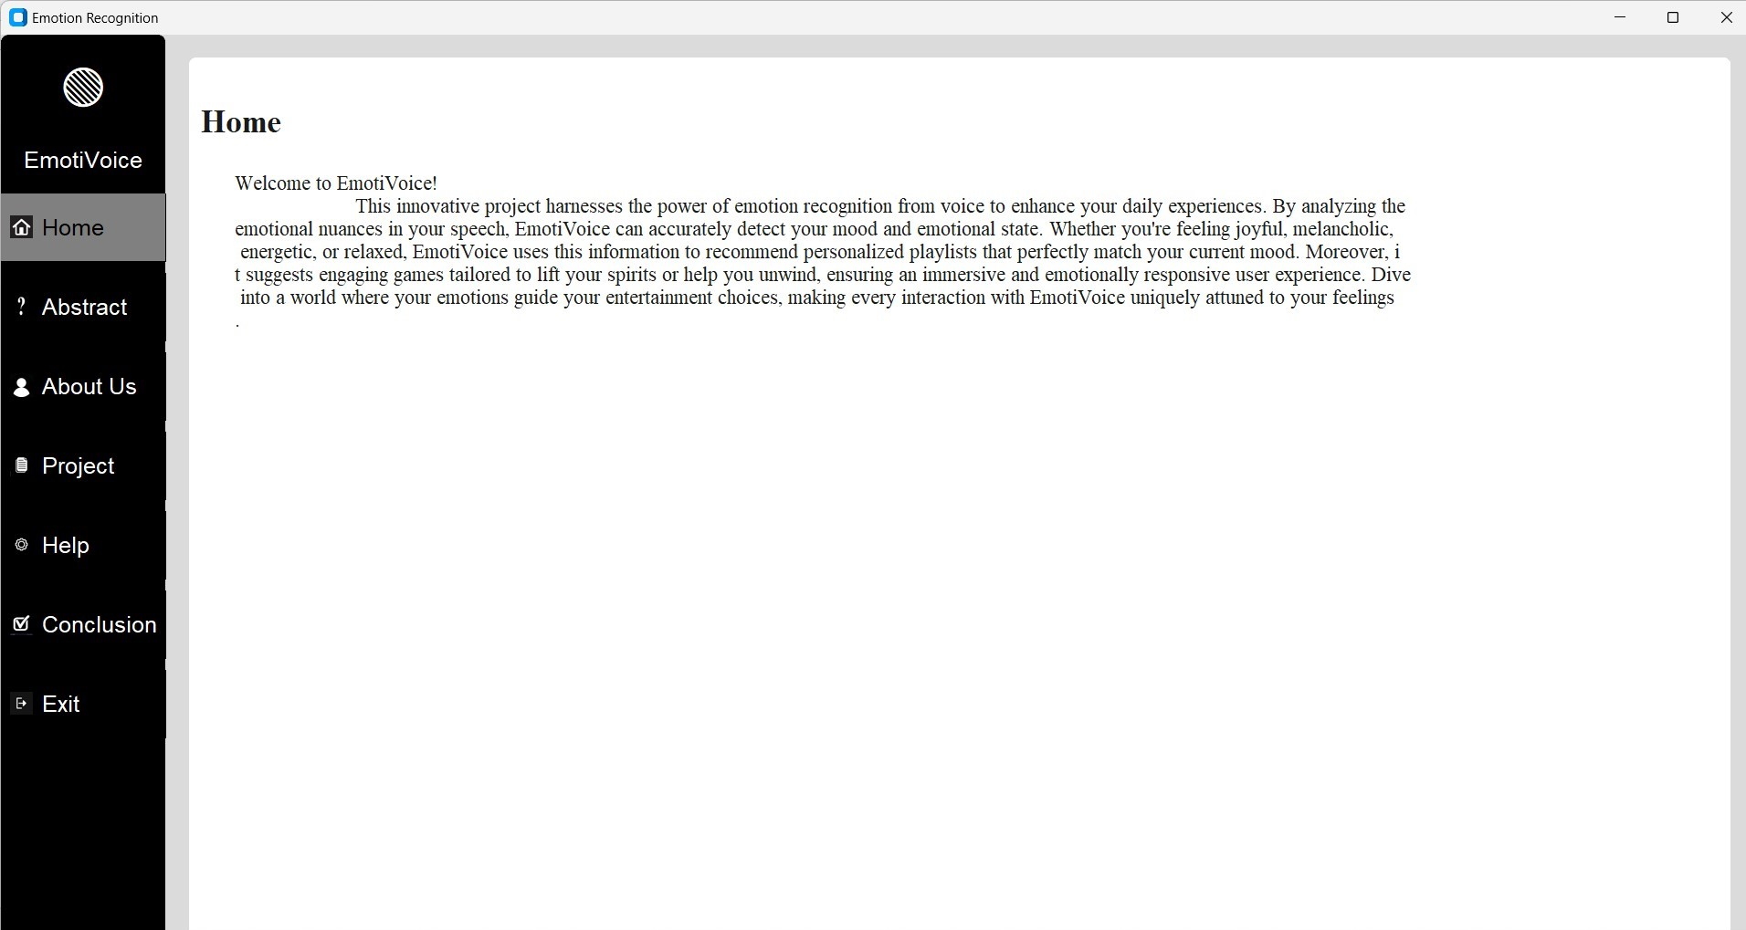
HOME PAGE

Slide 18
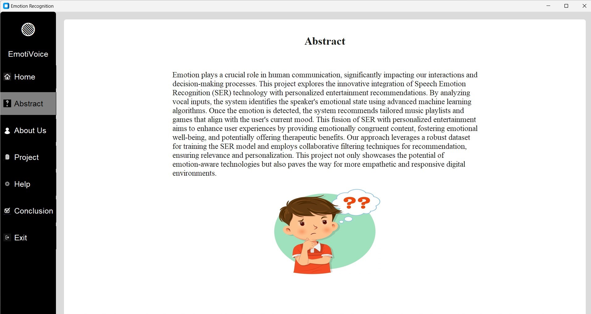
ABSTRACT PAGE

Slide 19
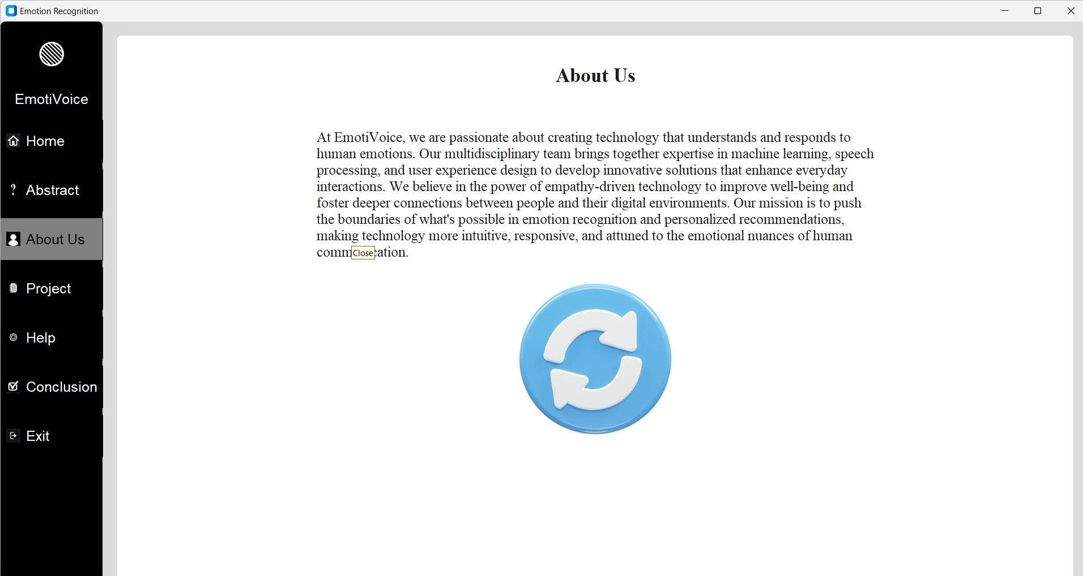
ABOUT US PAGE

Slide 20
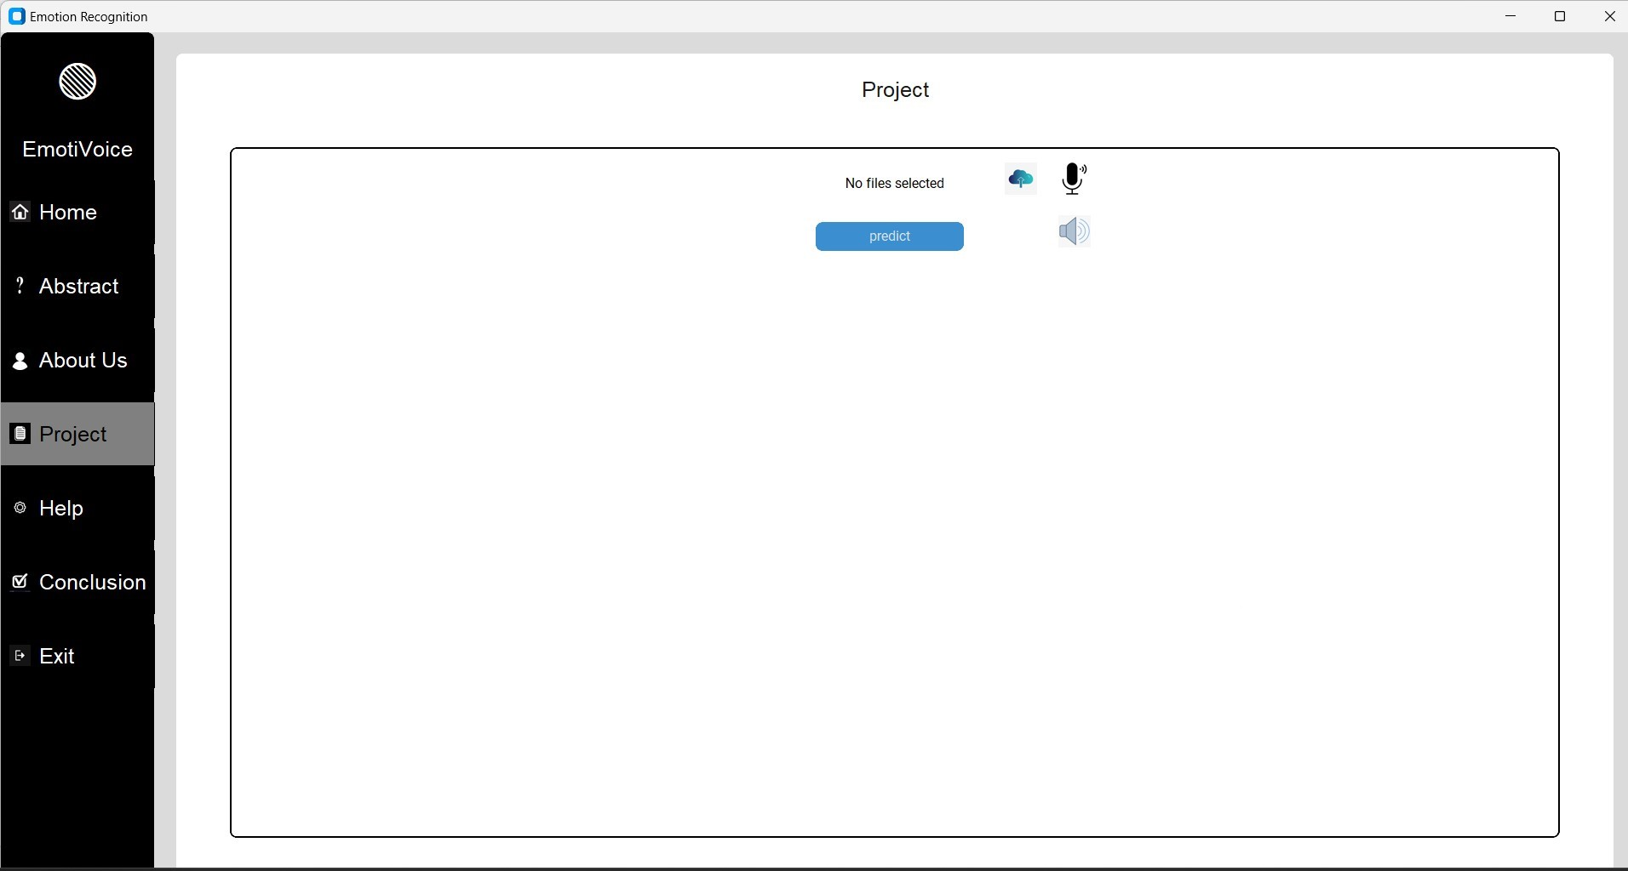
PROJECT PAGE

Slide 21
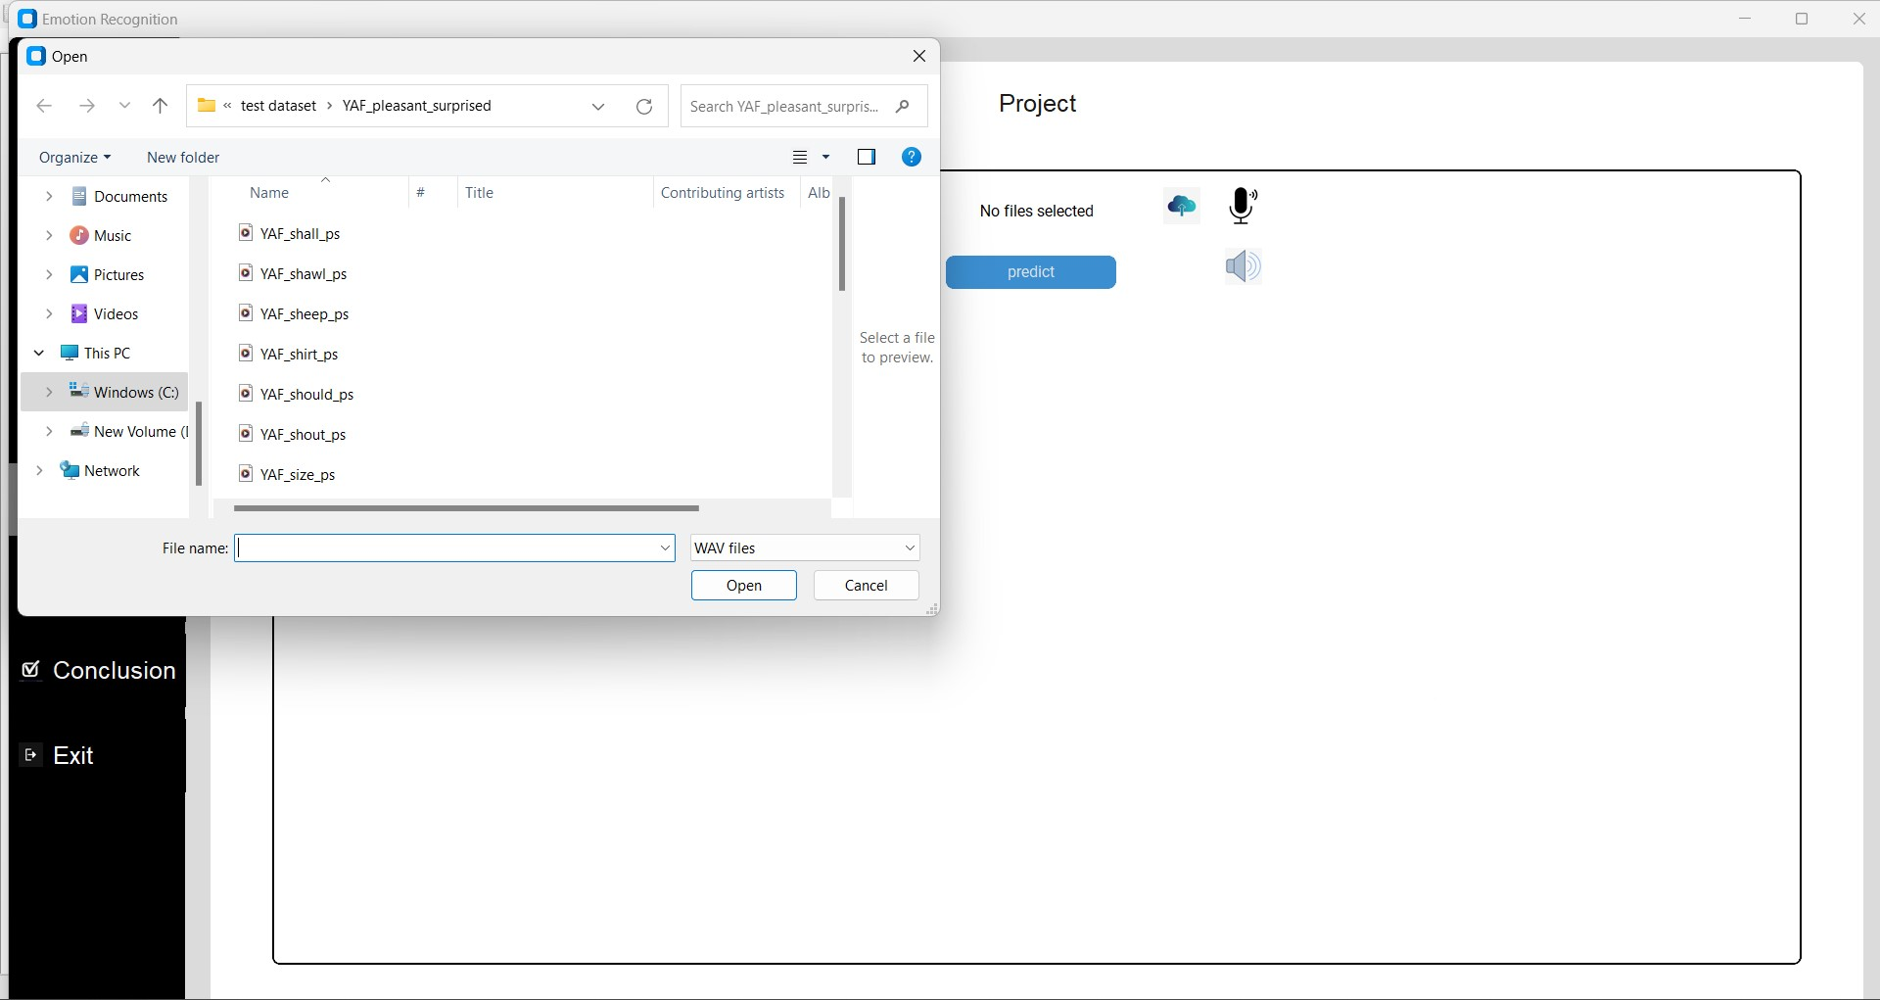
PROJECT PAGE

Slide 22
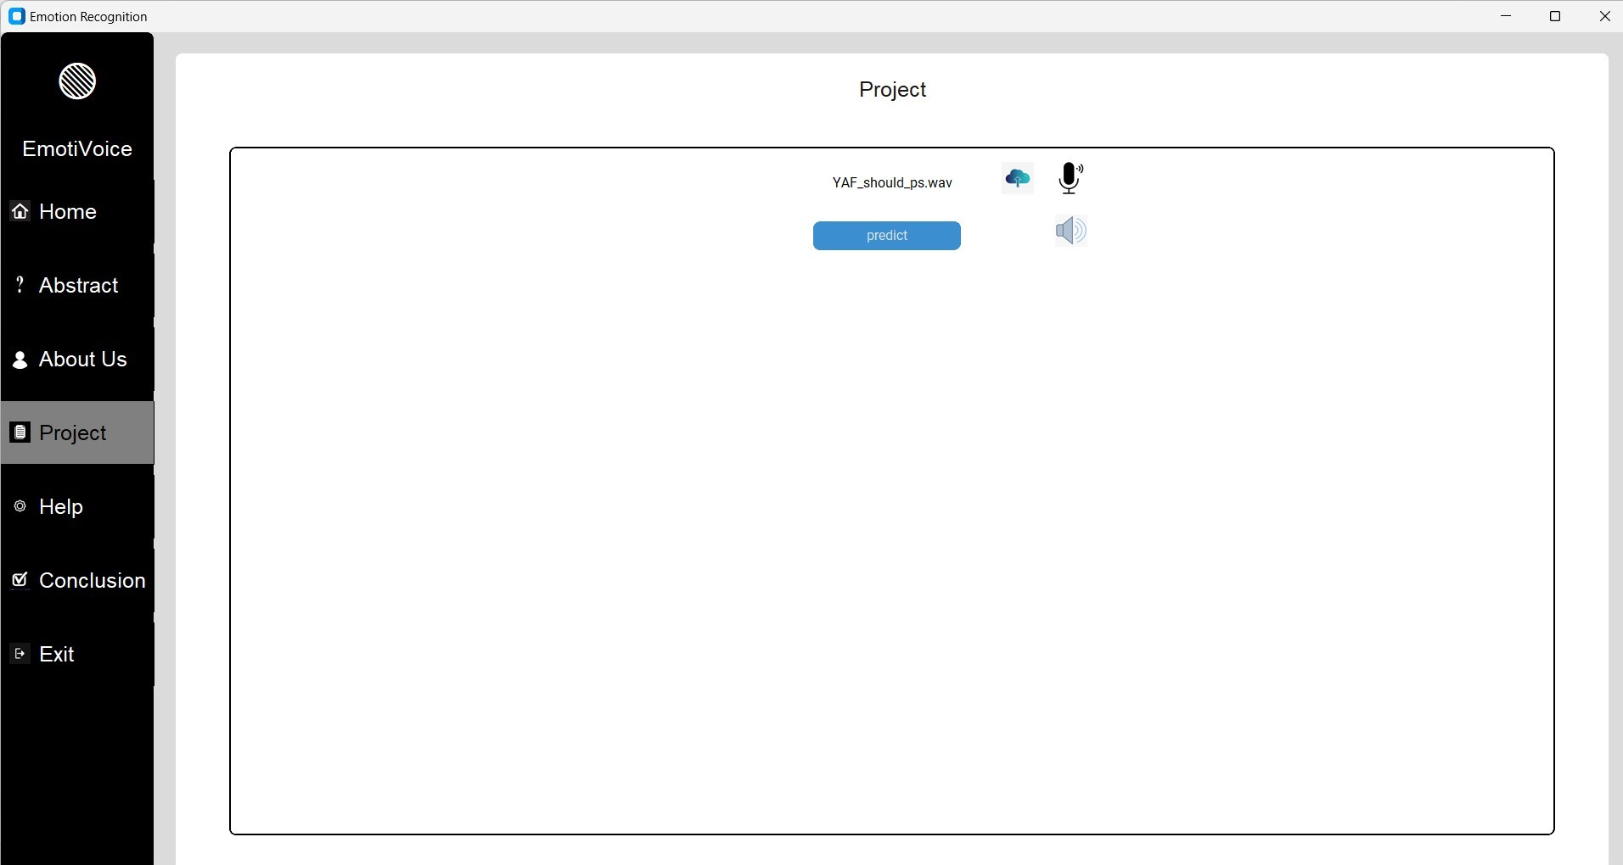
PROJECT PAGE

Slide 23
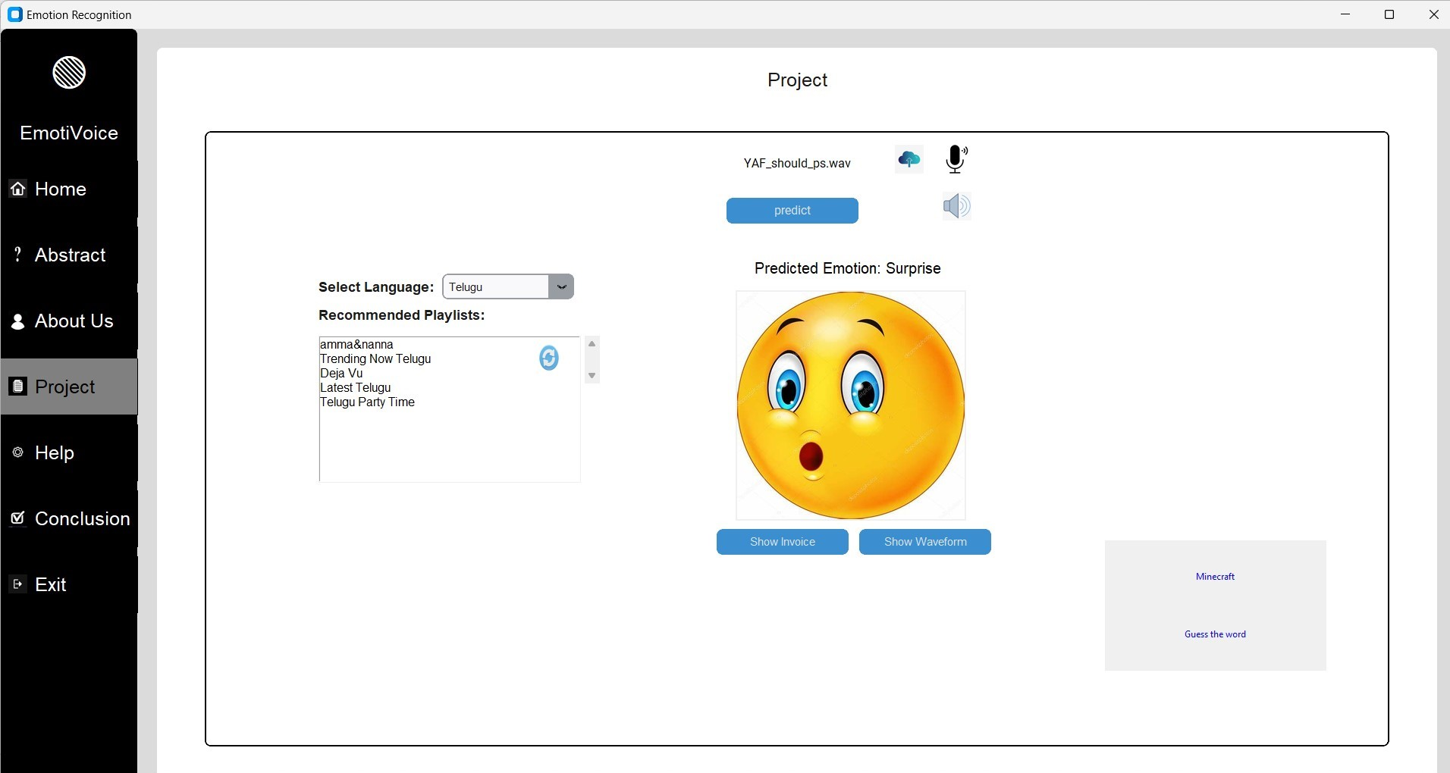
PROJECT PAGE

Slide 24
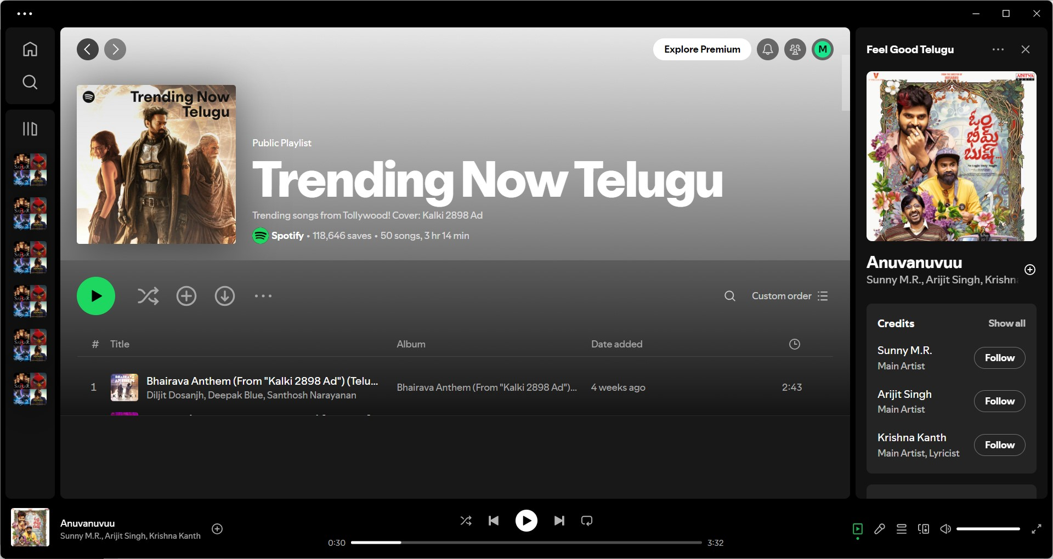
PROJECT PAGE

Slide 25

PROJECT PAGE

Slide 26
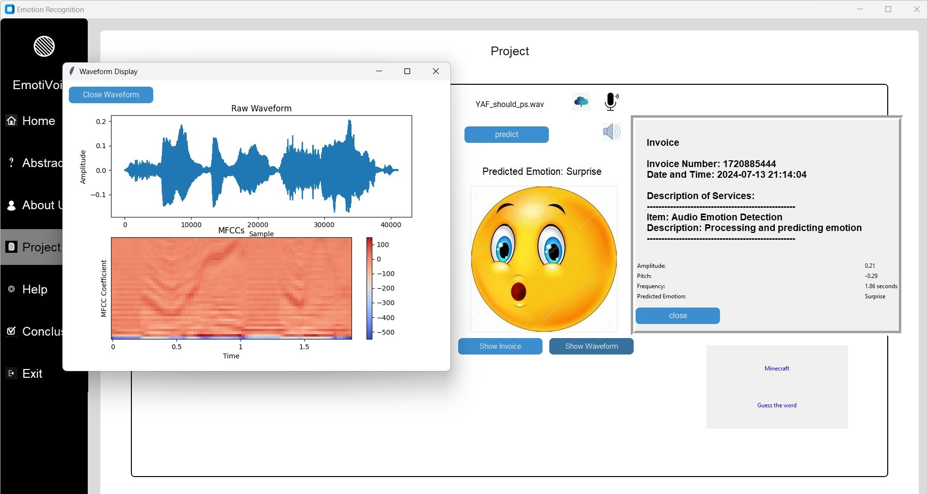
PROJECT PAGE

Slide 27
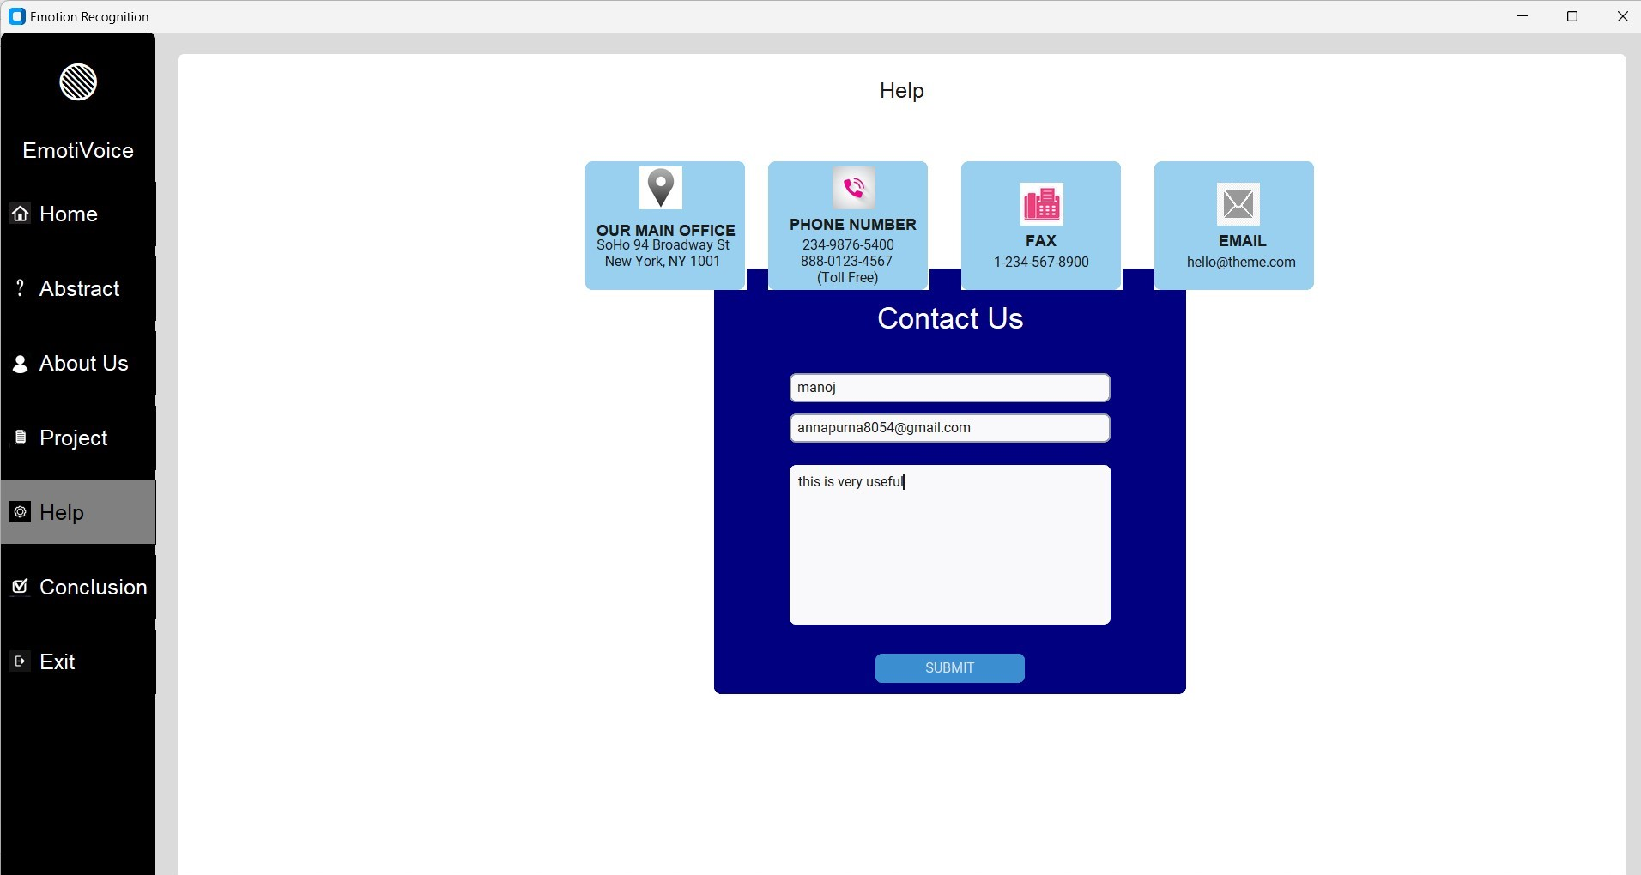
Help PAGE

Slide 28
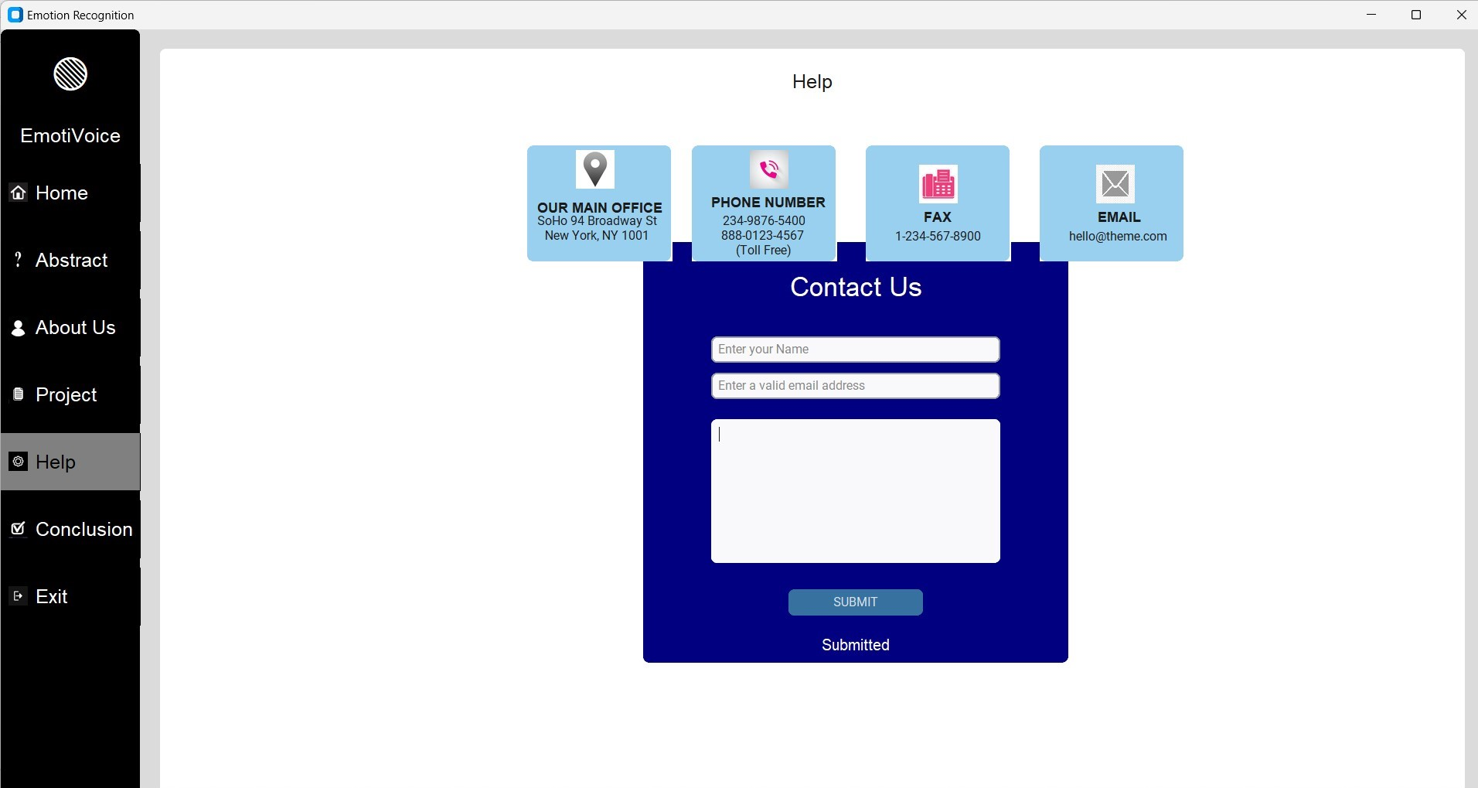
Help page

Slide 29
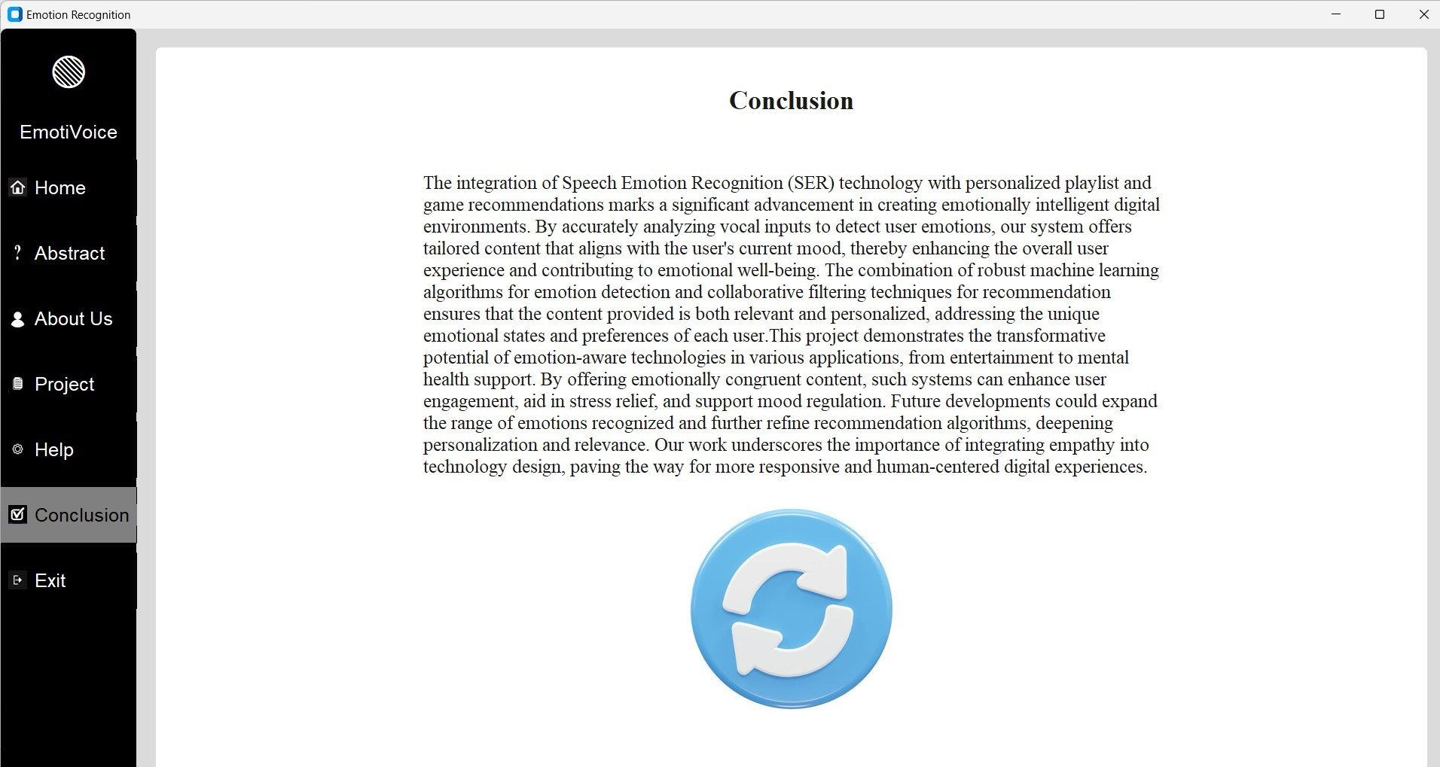
Conclusion

Slide 30
Conclusion
The integration of Speech Emotion Recognition (SER) technology with personalized playlist and game recommendations marks a significant advancement in creating emotionally intelligent digital environments. By accurately analyzing vocal inputs to detect user emotions, our system offers tailored content that aligns with the user's current mood, thereby enhancing the overall user experience and contributing to emotional well-being. The combination of robust machine learning algorithms for emotion detection and collaborative filtering techniques for recommendation ensures that the content provided is both relevant and personalized, addressing the unique emotional states and preferences of each user. This project demonstrates the transformative potential of emotion-aware technologies in various applications, from entertainment to mental health support. By offering emotionally congruent content, such systems can enhance user engagement, aid in stress relief, and support mood regulation. Future developments could expand the range of emotions recognized and further refine recommendation algorithms, deepening personalization and relevance.

